Slide 1


Green Pace
Security Policy Presentation
Developer: Steven Edmund
Notes:
Hello, my name is Steve Edmund, and I will be presenting the new Green Peace security policies.
So, without further ado, here is a quick rundown!

Slide 2

OVERVIEW: DEFENSE IN DEPTH
Defense in Depth (DID) implements safeguards to protect each and every layer of an organization.
In order to construct a layered security protocol, it is necessary to adhere to stringent procedures at all levels, from high-level planning to low-level code and even hardware.
When one layer is breached, the others will provide protection.
The cyber security industry uses it as a benchmark for excellence.
Notes:
An idea of defense in depth is presented. Defense in depth, as the name implies, is an approach to cybersecurity that employs multiple layers. There are multiple layers of protection, each with its own set of requirements. When one layer is breached, the one below it provides protection from further assaults, much like redundancy. It offers metrics for a wide range of processes and even hardware. Therefore, it's a very effective policy.

Slide 3
THREATS MATRIX
Threat Matrix Displays the potential danger in a graphical format
The potential damage of a danger is quantified by its severity.
Likelihood is a statistical tool for gauging the likelihood of an event.
Threats with high probability and severity are particularly destructive and coding standards to avoid it have high importance
Other considerations to consider include the cost and amount of difficulty to adopt the coding standard.
Likely and Less severe (Medium risk) | Likely and Severe (High risk)
Unlikely and Less severe (Lowest risk) | Unlikely and Severe (Medium risk)
Notes:
The threat Matrix is a means to see the potential dangers of a certain coding standard or style. Risk is measured in terms of its occurrence, impact, remediation expenditures, and complexity. The degree to which one coding method mitigates risk will determine its relative importance.

Slide 4
10 PRINCIPLES
Avoid vulnerabilities by checking input data.
Adhere to Compiler Warnings.
Create the Plan and Architecture for Security Measures.
Maintain a minimum of complexity.
If not explicitly allowed, the default is to reject.
Follow the rule of least privilege.
Clean Up Information Before Sending it to other systems.
In-Depth Defensive Practicing.
Implementing Quality Assurance.
Put in place a Secure Coding Practice.
Reference: Kirsh, A. (2022).
Notes:
On this slide we can see the top 10 principles of coding. Here, we make reference to Kirsh's Top 10 Secure C++ Coding Practices article.

Slide 5
CODING STANDARDS
Make sure the string is null ended if it's going to be used in C-style.
Prevent null references and dangling pointers.
Neither goto statements nor any other kind of ad-hoc branching are to be used.
Don't reinvent the wheel; instead, rely on tried-and-true library code.
Validate that unsigned integers don't overflow their values.
You should check the casting from float or double to integer range to make sure it's optimal.
In other words, float is not a valid counter variable.
Utilize garbage collected solutions, such as Bohme, for your next large C++ project's complexity.
Make advantage of exceptions rather than a hard stop when mistakes arise.
Never call a virtual function in a constructor or destructor.
Notes:
I have come up with certain coding standards, and they include common errors made by programmers in the field who aren't always conscious of the repercussions of their actions.

Slide 6
ENCRYPTION POLICIES
Encryption at Flight: It is referred to as "encryption at flight" if data is encrypted during transmission. Due to the increased probability of data encryption during transmission, practically all modern communications are encrypted in flight.
Encryption at Rest: The term "data at rest" is often used to refer to information that is currently stored on a disk. Data leakage may be avoided even if an attacker has access to the disk but has no decryption key if the data is encrypted while at rest. Data center administrators can keep sensitive information secure even while handling storage drives thanks to this.
Encryption in Use: The information stored on the disk must be visible to the user at all times. Key storage and other sensitive information must be kept encrypted and safe at all times.
Notes:
We are thinking of adopting a "zero trust" encryption policy, which means that nobody can be relied on to keep messages private. In these cases, any of the three possible encryption methods may be used.
The first one is Encryption at flight. In other words, it is the act of encrypting data before sending it across a network. Since the sending entity has little to no say over the receiving entity, transmission is the oldest and most reliable element of security. This means that the vast majority, if not all, of communications, are encrypted.
The second one is Encryption at rest. The disk-based data encryption is the main emphasis. When employees have access to a secure storage facility, data leakage is reduced. One way to do this is to guard the encryption key carefully.
The third one is Encryption in use. This section works to make some elements of the storage inaccessible to the user throughout their session. Any sensitive information, such as a secret key, must be protected from prying eyes.

Slide 7
TRIPLE-A POLICIES
Through its three distinct levels, it ensures that network resources be used safely:
Authentication: Authentication is the process of verifying the identity of a person by using some kind of secret information known only to that user (often a username and password). To get access to a system, authentication must first be performed. Any user who fails the authentication process will be denied access.
Authorization: Authorization establishes the limits of a user's privileges inside a system. Admins, by way of illustration, will have more privileges than regular members.
Accounting: Accounting involves keeping track of the user's actions so that they may be used as evidence in court. Additionally, it may be used in the detection of break-in attempts.
Notes:
Authentication, Authorization, and Accounting are sometimes abbreviated as Triple-A.
The authentication process determines who is allowed to access the system. In order to do that, we provide each user with a unique identifier and password.
The authorization phase determines which services the authenticated user is permitted to access. To provide one example, administrators will have more access than regular users.
Accounting is the process of keeping track of users' actions for the sake of later review, as well as throttling and intrusion detection.

Slide 8
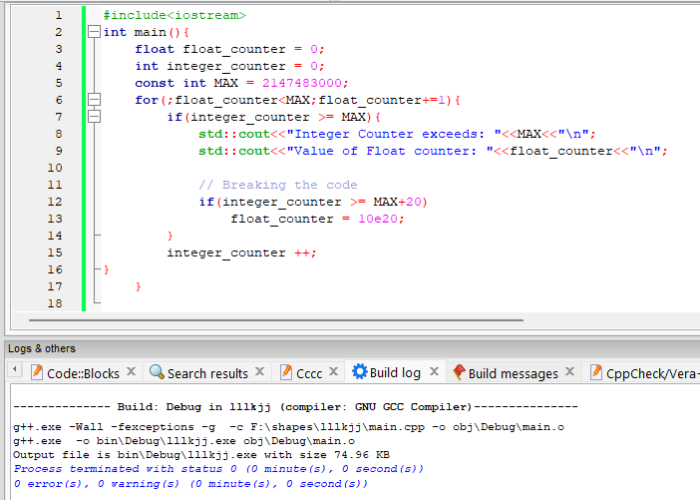
Flat Loops
Calculating the accuracy error introduced by floating points is the focus of this program. This is why there are counterarguments against their use.
Maximum was attained for the integer counter variable, whereas 1.67772e+007 was the highest value for the float counter. Due to rounding errors, adding 1 to 1.67772e+007 does not make it bigger.
The compiler did not flag this, but it needs fixing.
Notes:
Here we see the results of a float loop test. One should avoid counting using float. If the accuracy error is too great, we may never achieve the maximum or minimum value, and the process will continue indefinitely.

Slide 9
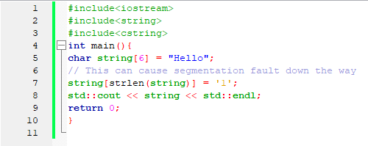
Non Null Terminated Strings
The following code produces the result:
Hello1α²⌂
Something about this doesn't match our expectations at all. Since we omitted the null terminator, the cout function was unable to reach the end of the string.
The consequences of forgetting to perform a null termination are severe but easily avoidable.
Notes:
In this slide, we see an example of a string that hasn't been ended, which is a typical error made by developers that may lead to serious issues.

Slide 10
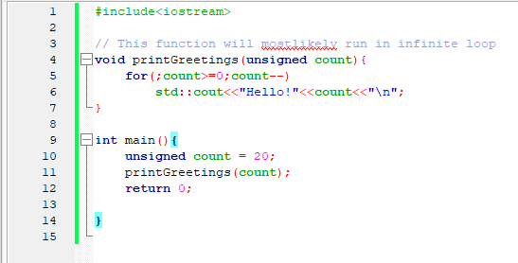
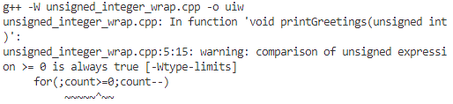
Unsigned Integer Wrapping
The for loop that is included inside the printGreetings function.
Regardless of the value of count, the greetings will continue indefinitely.
When the compiler is configured to produce warnings, the following warning will be generated:
Therefore, it is recommended to pay attention to all compiler warnings.
Notes:
You can see the unsigned integer wrapping test in action on this slide. When an unsigned integer is smaller than zero and we subtract from it, the result is positive rather than negative because the integer wraps around to its maximum value.

Slide 11
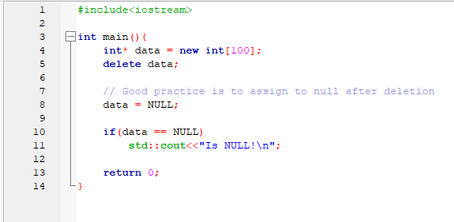
No dangling pointers
It is recommended that the pointers be set to NULL following deletion.
Notes:
In this slide, we see the hanging pointer scenario. When deleting or freeing a variable, it is recommended to set the variable's pointer to NULL.

Slide 12

AUTOMATION SUMMARY
Notes:
The DevSecOps process is shown in this figure. The graphic makes it easy to understand how DevSecOps incorporates security checks across the whole software development process.

Slide 13
TOOLS
DevSecOps pipeline: DevSecOps is an acronym that describes the collaboration between software engineers and IT security and operations professionals. The goal of this strategy is to make security a fundamental element of the program creation process. It helps in establishing security standards at the outset of software development and enhances those principles throughout operation. Effective software security is achieved by a combination of organizational culture, automation, and design.
During development, tools like the compiler and the debugger are utilized frequently. It's useful since they provide as early indications of possible weak spots.
Testing is an example of a tool that can be used both during and after development to find bugs and security flaws.
Notes:
The DevSecOps pipeline is a method for incorporating security best practices into the design phase of software creation. This ensures that the program is solid from the beginning.
Compilers, debuggers, and testing frameworks are some examples of additional tools that may be used to help reduce security risks.

Slide 14
RISKS AND BENEFITS
Up to a certain point, we can build a system completely risk-free. A viable benefit-to-cost ratio cannot be achieved after it has been exceeded.
Risks are always there in every system or piece of software, but they may be reduced with the right approach.
As prevention is always preferable to treatment, it is crucial for systems, particularly online systems like websites, to undergo risk analysis and elimination as soon as possible.
The operational phase also requires stringent inspections.
Therefore, the best way to ensure the safety of a system is to combine DevSecOps with a defense in depth strategy.
Notes:
We can only reduce security risks as far as the benefit-cost ratio will allow. There is no use in trying to eliminate risk if doing so would cost more than the danger itself.
However, it is imperative that we underline the need to minimize the threat to security. My view is that the combination of DevSecOps and defense in-depth is quite strong in terms of reducing risk.

Slide 15
RECOMMENDATIONS
There may be difficulties involved in conveying security principles to the developer.
When considering the process of developing software, security should not be viewed as an additional task but rather as an essential component of the process.
When it comes to the development cycle, simple strategies that are still effective and can be implemented on a day-to-day basis can be much more powerful than occasional expert analysis.
Notes:
Although rules may be formulated, it may be difficult to convey them to programmers. That's why it's helpful to maintain policies consistent and easy to understand. Rather than having specialists check in on the system occasionally, we should make the security principles consistent.

Slide 16
CONCLUSIONS
As a result, the previously discussed rules place an emphasis on combining the concepts of security with the development cycle.
The coding standards will significantly improve software safety.
Furthermore, a company's software development culture may undergo significant changes as a result of implementing a defense in depth strategy, which may ultimately result in better secure software.
Additionally, we have established a zero-trust approach for all communications, which ensures the utmost security by encrypting data at all times.
The triple-A architecture is also useful for detecting data breaches.
Notes:
So, to sum up, it is indeed clear that combining development and security principles helps produce more resilient software. In addition, not putting any faith in any of the involved parties, but rather adopting a zero-trust communication strategy and striving to fix any problems that may arise, may make the system very secure.

Slide 17
REFERENCES
C++ coding standards: 101 Rules, guidelines, and best practices. µOS++ IIIe. (2018, March 26). Retrieved December 10, 2022, from https://micro-os-plus.github.io/develop/sutter-101/
Kirsh, A. (2022, August 16). Top 10 secure C++ coding practices. Incredibuild. Retrieved December 10, 2022, from https://www.incredibuild.com/blog/top-10-secure-c-coding-practices

